Slide 1

Javascript on the server. A Node.js crash course
Julian Nalenz
Valentin Dimov
Robert Dillitz

Slide 2
What is Node.js?
asynchronous event driven JavaScript runtime
designed to build scalable network applications
built on Google’s V8 JavaScript engine
free & open source

Slide 3
Why use Node.js?
to “javascriptify” the whole stack
to handle a lot of concurrent connections at once
has become THE standard environment for JS-related tools
synergizes well with an agile development style
tons of available packages through npm

Slide 4
When (not) to use Node.js?
YES
lots of concurrent connections
building a real-time application
(e.g. chat or gaming)
great for data streaming
perfect for microservices
NO
application requires heavy computational power
simple HTML or CRUD applications

Slide 5
Single threaded operation

Slide 6
Blocking vs. Non-Blocking
const fs = require('fs');
fs.readFile('/file.md', (err, data) => {
if (err) throw err;
console.log(data);
});
fs.unlinkSync('/file.md');
const fs = require('fs');
fs.readFile('/file.md', (readFileErr, data) => {
if (readFileErr) throw readFileErr;
console.log(data);
fs.unlink('/file.md', (unlinkErr) => {
if (unlinkErr) throw unlinkErr;
});
});

Slide 7
How does the event loop work?

Slide 8
The Node.js ecosystem

Slide 9
NPM - Node Package Manager
Utility to install, update and manage dependencies of Node packages
Online searchable repository: npmjs.org
Available as a command line uitlity
Pre-packaged into Node.js since version 0.6.3

Slide 10
package.json
Describes project properties
name
version
description
main
scripts
...
Located in the root directory of the project
Used by npm to locate the project directory
Utility to create it automatically: npm init

Slide 11
Other npm utilities
npm install <module name> [--save-prod/--save-dev/--save-optional/--no-save]
Install a package from the online repository
By default installs locally (in node_modules/)
Add the -g flag to install globally
You may need to supply the full path to globally installed modules when importing
The last option updates the dependencies (also done by default), devDependencies or optionalDependencies of you package.json. --no-save prevents this update.
npm uninstall <module name> - works similarly.

Slide 12
Other npm utilities
npm ls [-g] - List (globally) installed packages
npm search <module name> - Search for a module in the repository
npm adduser - npm will prompt for a username, password, and email. If you are already registered, this will function as a login, otherwise, it will register a new user. Identical to npm login
npm publish - After you’re logged in, publish your module to the online repository

Slide 13
Gulp
Tool for automating tasks (build-related or otherwise), similar concept to make
Executes a gulpfile, (usually) written in JavaScript
Installable as npm packages: gulp-cli (global), gulp (local/global)
Offers a rich API, accessible by require(‘gulp’)
const {src, dest, watch} = require(‘gulp’);

Slide 14
Gulpfile
Can be implemented as:
gulpfile.js (Gulpfile.js) in the project’s directory
gulpfile.js/index.js (gulpfile.js is a directory)
In principle, it’s just JavaScript - it can be split in modules or import modules
Other languages can also be used by setting the gulpfile’s extension and installing the proper transpiler module
Exported functions (the exports object) are the public tasks Gulp can execute
exports.default = default task
Execution: gulp <Task1> <Task2> … in the project directory
Simply using gulp will execute the default task

Slide 15
Tasks, asynchronicity, and the Gulp API
Tasks must be compatible with asynchronous completion
They could return a promise, stream, event emitter or a child process
They, themselves, could be an async function
Alternatively, they can accept an error-first callback as a parameter (the errors are represented by the Error class) and call it upon completion
This allows tasks to be composed, using the series() and parallel() functions
series() : The tasks are completed one after the other
parallel() : The tasks may be processed in a quasi-parallel manner
Both can be arbitrarily nested:
exports.doSth = series(parallel(A, series(B,C)),D)

Slide 16
More on the Gulp API: Working with files
“Globs” : Expressions that match filenames
...or an array of expressions (“collected” left-to-right)
Separator is always /, even in Windows
* : Any sequence of characters in a single file/directory name
** : Any sequence of characters in the entire path (across separators)
\\ : Escape character (for wildcards)
! : When evaluating an array, remove matching paths from the already collected ones

Slide 17
More on the Gulp API: Working with files
src(glob) : Reads the files matching the glob into a readable Node stream
dest(path) : writable Node stream to the specified path. Re-emits the data it’s given to allow piping
stream.pipe(another stream) : Pipes the output of the first stream through to the input of the second stream. Outputs the output of the second stream.
Example using the gulp-babel transpiler plugin:
exports.default = function() {
return src(‘src/*.js’).pipe(babel())
.pipe(dest(‘output/’)); }

Slide 18
More on the Gulp API: Plugins and file watchers
Plugins: Node Transform streams (receive input, transform it, emit output)
Used with pipe() to transform files
Renaming files, transpilation, minifying, etc.
Available as npm packages with gulpplugin or gulpfriendly keywords
watch(glob, task) : Execute a task as soon as one of the files matching the glob is added, deleted or changes. If the task does not signal async completion, it won’t be run again.
Allows watching for additional events, delaying, queueing, etc.

Slide 19
Webpack
Widely used tool for bundling JavaScript modules
NPM packages: webpack-cli, webpack
Highly configurable, it supports a wide range of activities including dependency management, optimization and transpilation. Plugins allow some highly specific activities to be easily integrated into the process.
Usage: npx webpack [--config <config filename>] or as an NPM script

Slide 20
TODO

Slide 21
Express
Lightweight, flexible framework for building web apps
NPM module: express
Greatly simplifies the handling of HTTP requests
Support for a wide array of plugins
body-parser: For parsing encoded form data (e.g. from a POST request)
cookie-parser: For parsing cookies
etc.

Slide 22
Express apps: Creation and request handling
Loading Express: const express = require(‘express’);
Creating an app: let app = express();
Registering handler functions for HTTP requests:
app.get(url, function (req, res){...}); //GET request
app.post(url, function (req, res){...}); //POST request
...
req = object containing request data (e.g. form fields)
res = object containing response functions (send(), sendfile(), end(), …)
Starting the server: let server = app.listen(port, callback)
Properties: server.address.host, server.address.port

Slide 23
Express apps: Handling forms
GET method: Data in req.query.<field name>
POST method: Data is in the body. In case of URL-encoded data, we can use the body-parser middleware:
const bodyParser = require(‘body-parser’);
let urlencodedParser = bodyParser.urlencoded();
app.post(‘/form’, urlencodedParser, function(req, res) {
//Data in req.body.<field name>
...
})

Slide 24
Express apps: Other middlewares
Express offers the express.static middleware to serve static content
Usage: app.use(express.static(dirName));
Files in this directory will be served as static pages
cookie-parser middleware to parse cookies in the request object
const cookieParser = req(‘cookie-parser’);
app.use(cookieParser());
app.get(‘/’, function(req, res) {
console.log(“Cookies: “, req.cookies);
})

Slide 25
Hapi
Another framework for building web apps

Slide 26
The Bayesian Survival Analysis approach
TODO (by Valentin)

Slide 27
The Neural Network approach
used ML library: Keras
has a TensorFlow backend
allows training and predicting on the GPU for optimal speed
Open Source, Python
“was developed with a focus on enabling fast experimentation”
in our project: densely connected layers only

Slide 28
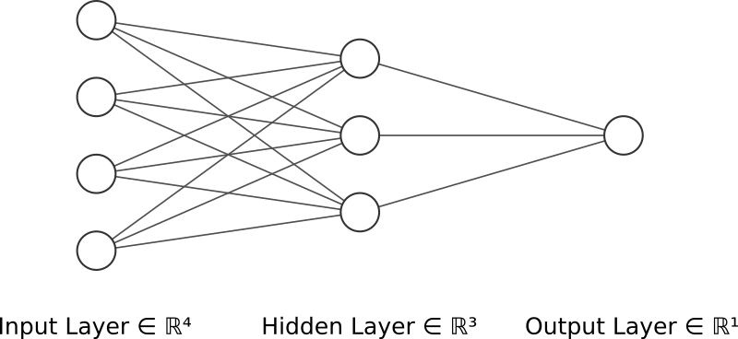
Basics of neural networks
mathematical abstraction of neurological data processing
input and output data are vectors of real numbers
feedforward through the layers is matrix multiplication
activation function used in neurons to model their action potential
learning using an optimizer (backpropagation)

Slide 29
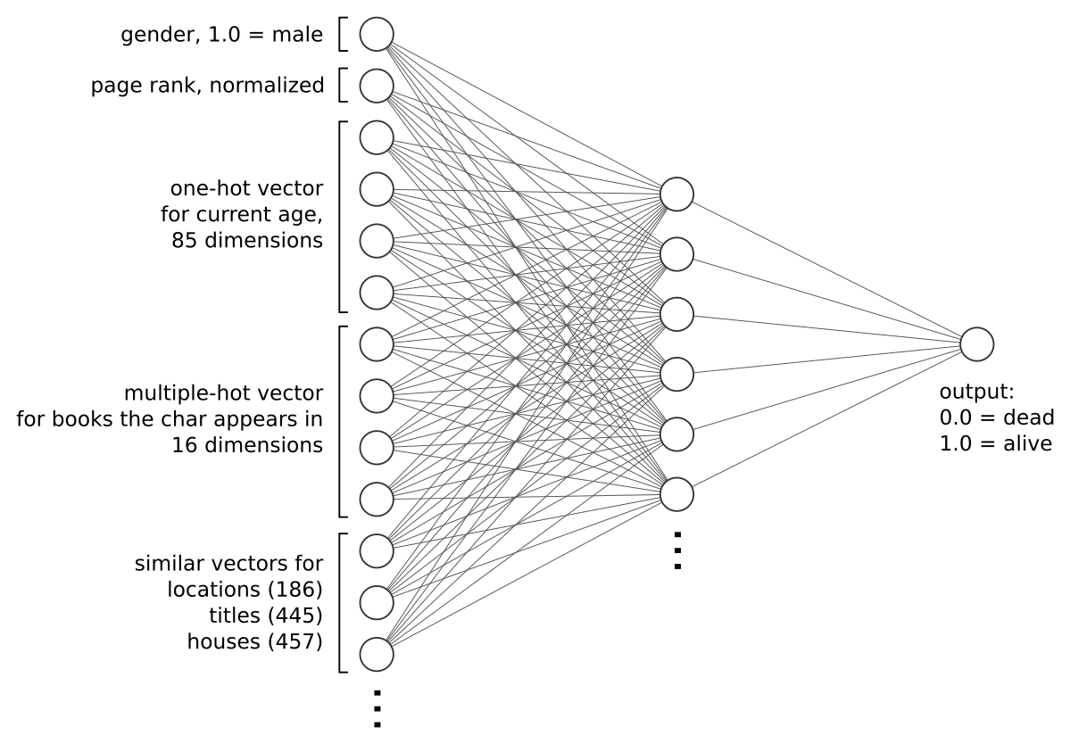
Our model for the book data

Slide 30
Other model considerations
current age input is arbitrary
possibility to expand training data considerably
predictions for transitioning PLOD over time can be determined
alternative architecture: output as one-hot vector corresponding to the number of years the character has left to live

Slide 31
Results
TODO

Slide 32
Outlook
TODO

Slide 33
Sources
Michael A. Nielsen, Neural Networks and Deep Learning, Determination Press, 2015
Keras Documentation. Retrieved March 26, 2019 from https://keras.io

Slide 34
Dr. rer. nat. Erika Mustermann
München, 27. März 2015

Slide 35
Gültigkeit der Masterfolien
Dieser Folienmaster gilt bei offiziellen Präsentationen im Rahmen der TUM. Es ist darauf zu achten, dass wir uns in einem durchgängigen Layout präsentieren.
Abweichungen vom vorgegebenen Layout bitte auf ein Minimum reduzieren.

Slide 36
Grundlage der Masterfolien
Als Grundlage dient der Corporate Design Style Guide der TUM. Die Präsentationsvorlage ist auf gute Lesbarkeit und klare Darstellung von Informationen optimiert.

Slide 37
Hier steht eine Überschrift max. 2-zeilig
Als Grundlage dient der Corporate Design Style Guide der TUM. Die Präsentationsvorlage ist auf gute Lesbarkeit und klare Darstellung von Informationen optimiert.

Slide 38
Schrift
Das Grundprinzip ist, Informationen bestmöglich zu transportieren. Dazu muss vor allem die Schrift einheitlich und für alle im Raum lesbar sein.
Schriftart: Arial
Schriftgrößen: 25 | 18 | 14 | 11
Zeilenabstand: 1,15mm
Die Einstellungen sind in den Textfeldern und Textfeldvorlagen dieses ppt-Masters als Standard eingestellt. Bei Diagrammen und Tabellen muss die Schriftgröße ggf. angepasst werden. Für Auszeichnungen im Fließtext kann auch fett markiert werden. Bei großer Distanz bzw. kleinem Präsentationsmedium kann der Schriftgrad notfalls proportional erhöht werden.

Slide 39
Farben
Als erstes soll mit schwarz und weiß gearbeitet werden. Für Aufwändigere Darstellungen sind Farben mit Bedacht und in möglichst geringem Umfang einzusetzen. In diesem Folienmaster ist die Farbpalette festgelegt.
Zuerst mit den Primärfarben arbeiten.
Für z.B. komplexe Diagramme stehen noch Sekundärfarben zur Verfügung.
Gering im Einsatz sind die Akzentfarben.

Slide 40
Texte
Kurze und knappe Texte, Fließtexte linksbündig, kein Blocksatz
Beispiel:
Tem soluptam, nisi as verum ereprehendam at acculpa quidisq uissit volupta tusdant utem as etur, odi odis es doluptiae dem nimaion con nossinctenis pora quam voloria consenimus blabore everfer epeliquo maio etur.

Slide 41
Bilder - Allgemein
schlichte Darstellung von Informationen
reduzierte Farben
Rahmen und Überlagerungen nach Möglichkeit vermeiden

Slide 42
Aufzählung
Bei kleinen Aufzählungen auf Aufzählungszeichen verzichten und ggf. zusätzliche Leerzeile
Nur die wesentlichen Punkte nennen und Themen auf verschiedene Seiten splitten.
Punkt 1
Punkt 2
Wenn Unterpunkte in einer Aufzählung nötig sind ist ein Einrücken mit – möglich
Unterpunkt 1
Unterpunkt 1
Unterpunkt 2
Bei größeren Listen die Standardeinstellung • verwenden
Unterpunkt 1
Unterpunkt 2

Slide 43
Bilder
Bildbeschreibung oberer Bildrand: Begrenzung durch Text

Slide 44
Bilder
Bildbeschreibung oberer Bildrand: Begrenzung durch Text

Slide 45
Bilder
Bildbeschreibung oberer Bildrand: Begrenzung durch Text

Slide 46
Nicht formatfüllende Bilder
Weißer bzw. transparenter Hintergrund mit genug Freiraum anordnen

Slide 47
Bilder Format füllend - maximale Bildgröße

